Slide 1
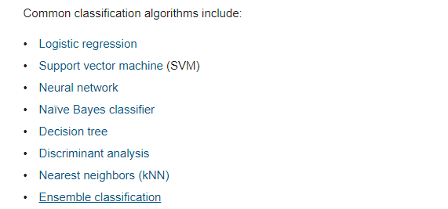
Supervised Learning

Slide 2
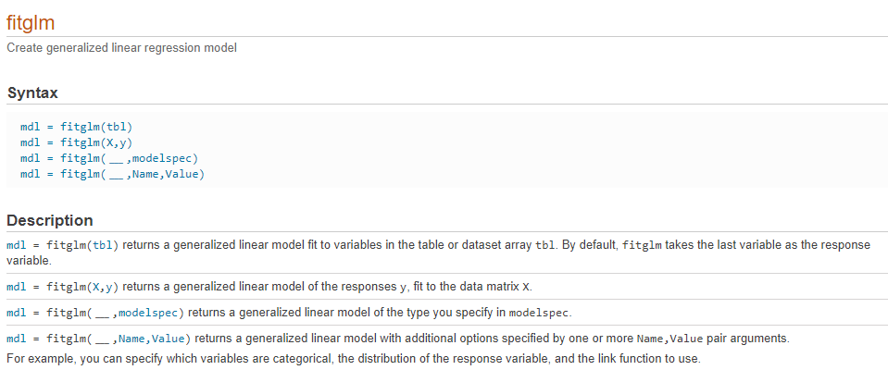
Logistic Regression
https://www.mathworks.com/help/stats/fitglm.html#bt0dghf-2

Slide 3
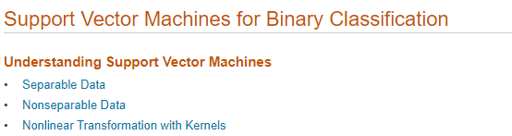
Support Vector Machine (SVM)
https://www.mathworks.com/help/stats/support-vector-machines-for-binary-classification.html

Slide 4
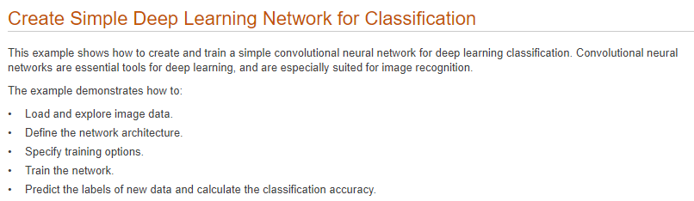
Neural Network
https://www.mathworks.com/help/deeplearning/ug/create-simple-deep-learning-network-for-classification.html?s_tid=srchtitle

Slide 5
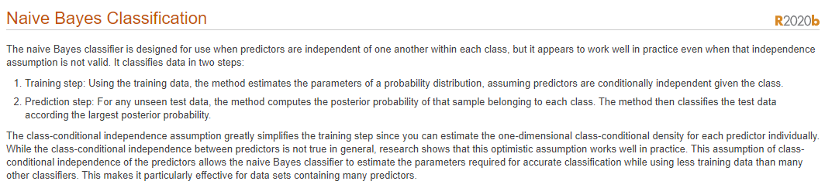
Naïve Bayes Classifier
https://www.mathworks.com/help/stats/naive-bayes-classification.html

Slide 6
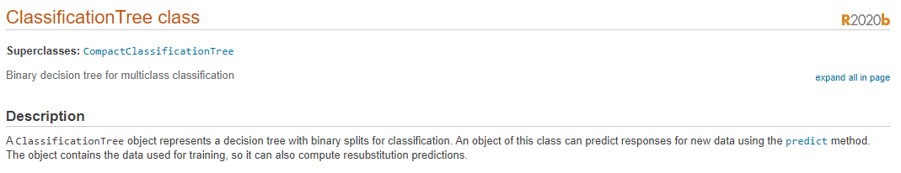
Decision Tree
https://www.mathworks.com/help/stats/classificationtree-class.html

Slide 7
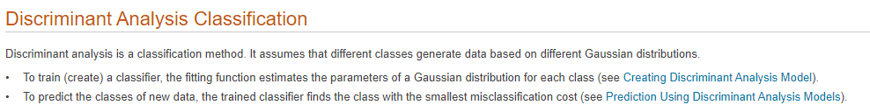
Discriminant Analysis
https://www.mathworks.com/help/stats/discriminant-analysis.html

Slide 8
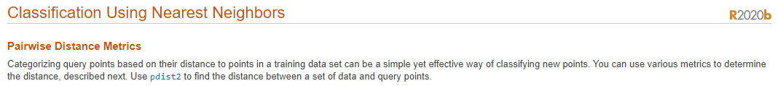
Nearest Neighbors (kNN)
https://www.mathworks.com/help/stats/classification-using-nearest-neighbors.html

Slide 9
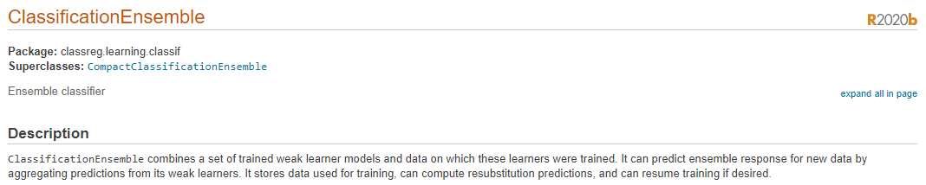
Ensemble Classification
https://www.mathworks.com/help/stats/classreg.learning.classif.classificationensemble-class.html

